Slide 1
Creating
MOTION
From Still Images
Using Photoshop
David Blass July 16, 2020

Slide 2
Why Do It?
-It’s fun
-It’s creative
-It’s a challenge

Slide 3
2 Techniques:
-Frame by Frame Video
-Animated GIF
(to be covered another time)

Slide 4
Frame by Frame Video
-Each frame is a separate photo
-Can create smooth motion
-Time-lapse photography

Slide 5
Examples
-movement of sun or stars
-“a day in the life. . .”
-watch a flower open & close
-give motion to inanimate objects

Slide 6
Move
Inanimate
Objects

Slide 8
Order
From
C
H
O
A
S

Slide 10
What you need:
-a camera
-imagination
-Adobe Photoshop
Helpful to have:
-intervalometer
-tripod

Slide 11
Goal:
Create a series of photos,
numbered consecutively, showing
incremental change. Each photo
becomes a frame of your video.
Commonly, 24 frames=1 second

Slide 12
Before you start:
-Have an empty SD card
-Have a fully charged battery
-Use aperture priority
-Select the white balance (not auto)
-Turn off image review
-Have an empty folder in your
computer to receive the images

Slide 13
Sample calculations
length of video
X frames per second =
total frames
elapsed time
/ total frames =
shooting interval
length of video (seconds)
5
30
frames per second
24
24
total frames
120
720
elapsed time (seconds)
3600 (1 hr.)
3600
shooting interval (seconds)
30
5

Slide 14
How to make a video
1.Take the photos
2.Put them in the empty folder
3.Numbering should be consecutive
4.To run the sequence backwards,
use a file renaming program

Slide 15
File Renaming Programs
Windows: File Renamer (free)
https://www.microsoft.com/en-us/p/file-renamer/9nblggh68201?activetab=pivot:overviewtab
Mac: NameChanger (free)
https://mrrsoftware.com/namechanger/

Slide 16
How to make a video
5.Process the files in Photoshop
6.Save the video
(watch demo)

Slide 17
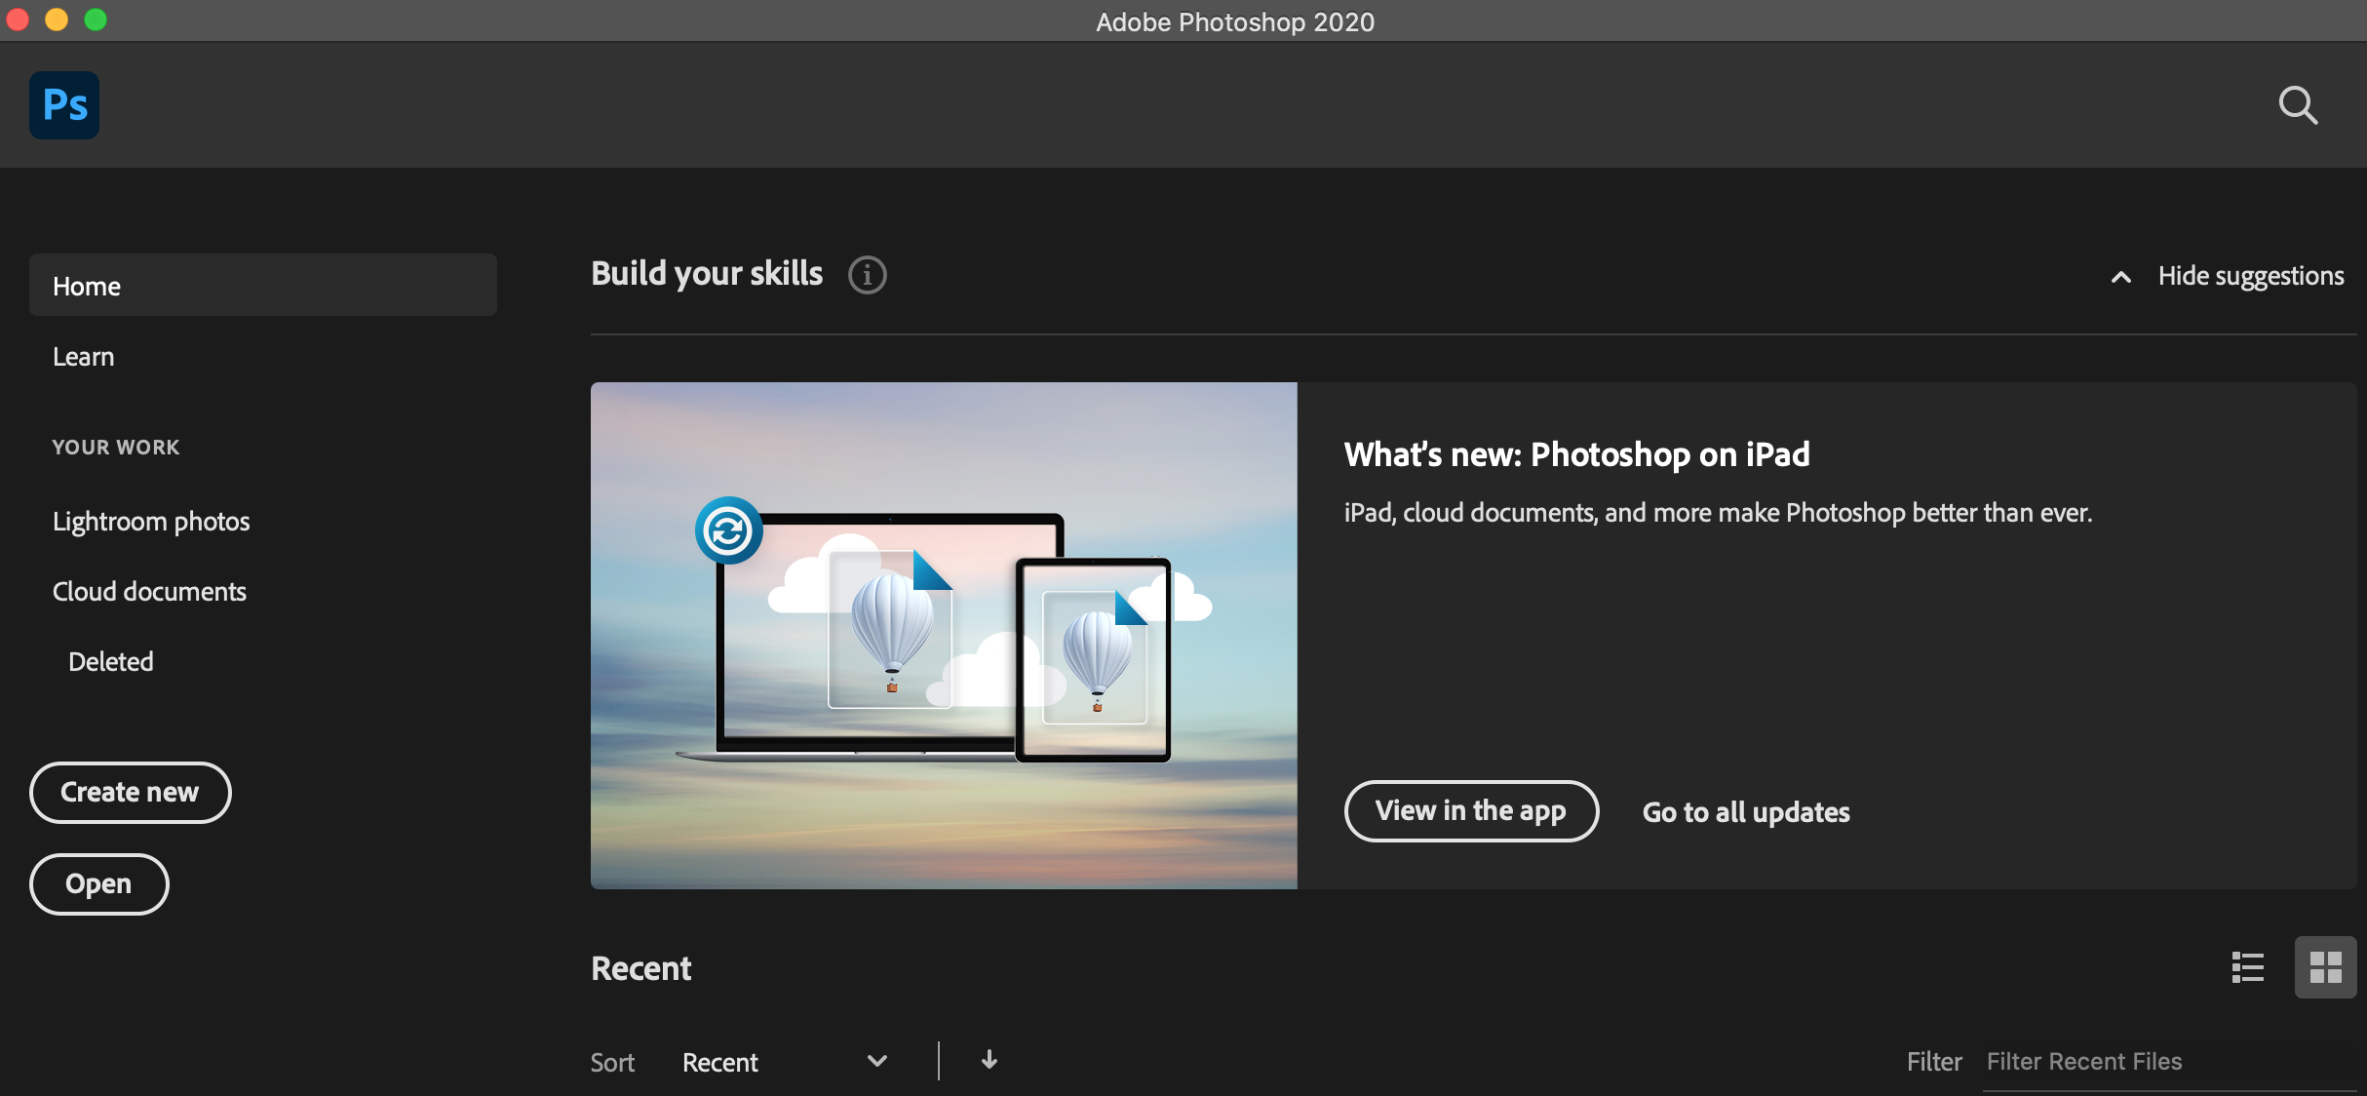

Slide 18
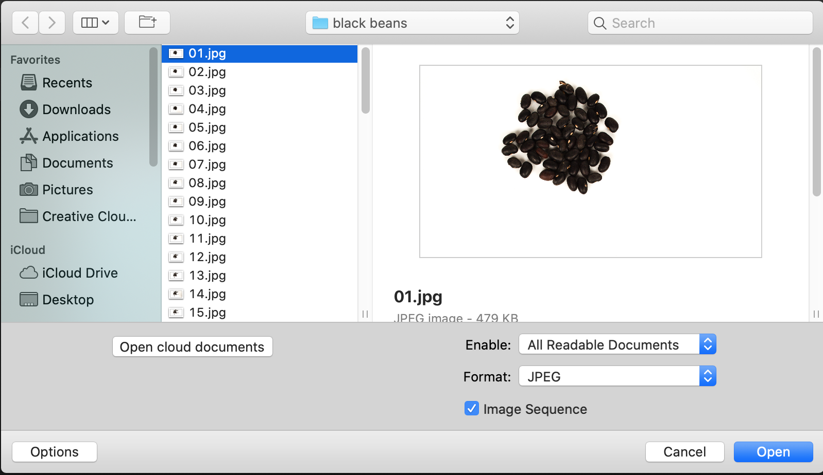

Slide 20
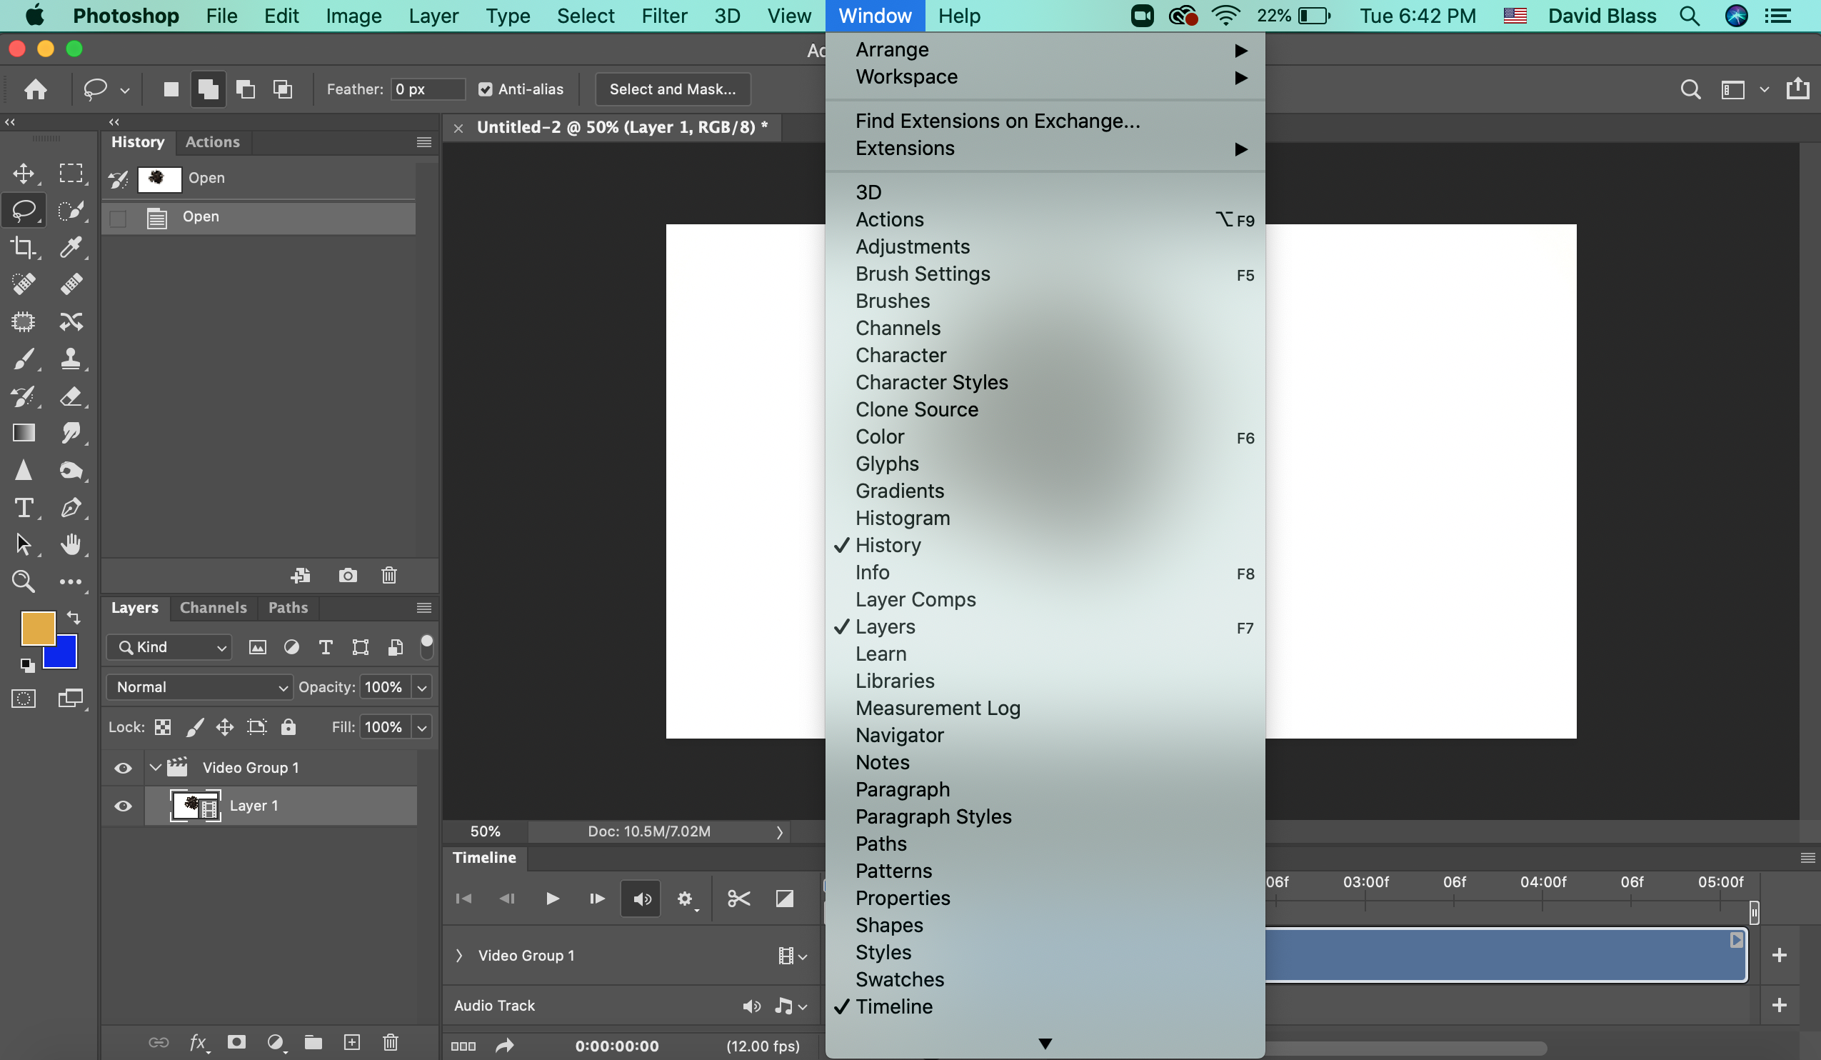

Slide 21
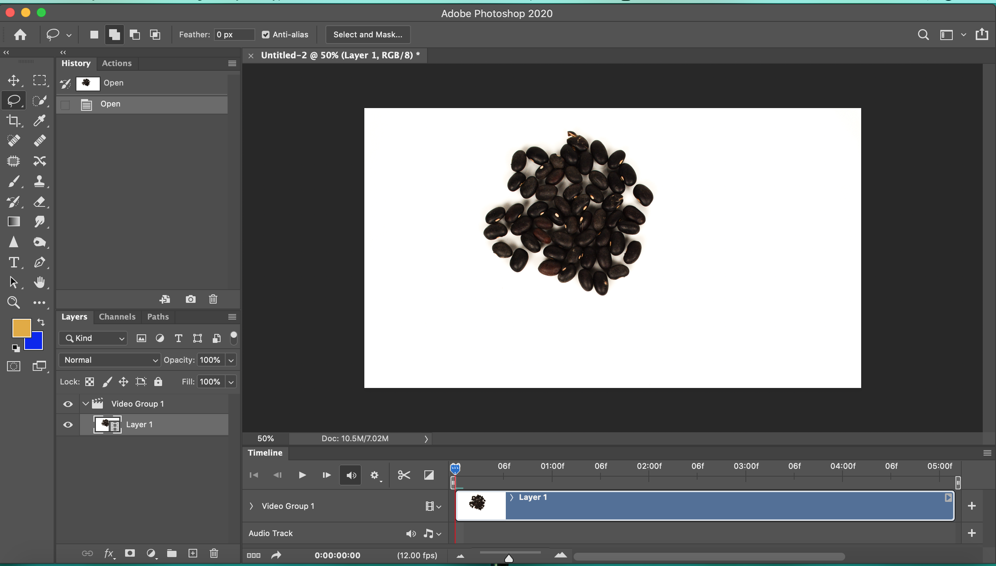

Slide 23
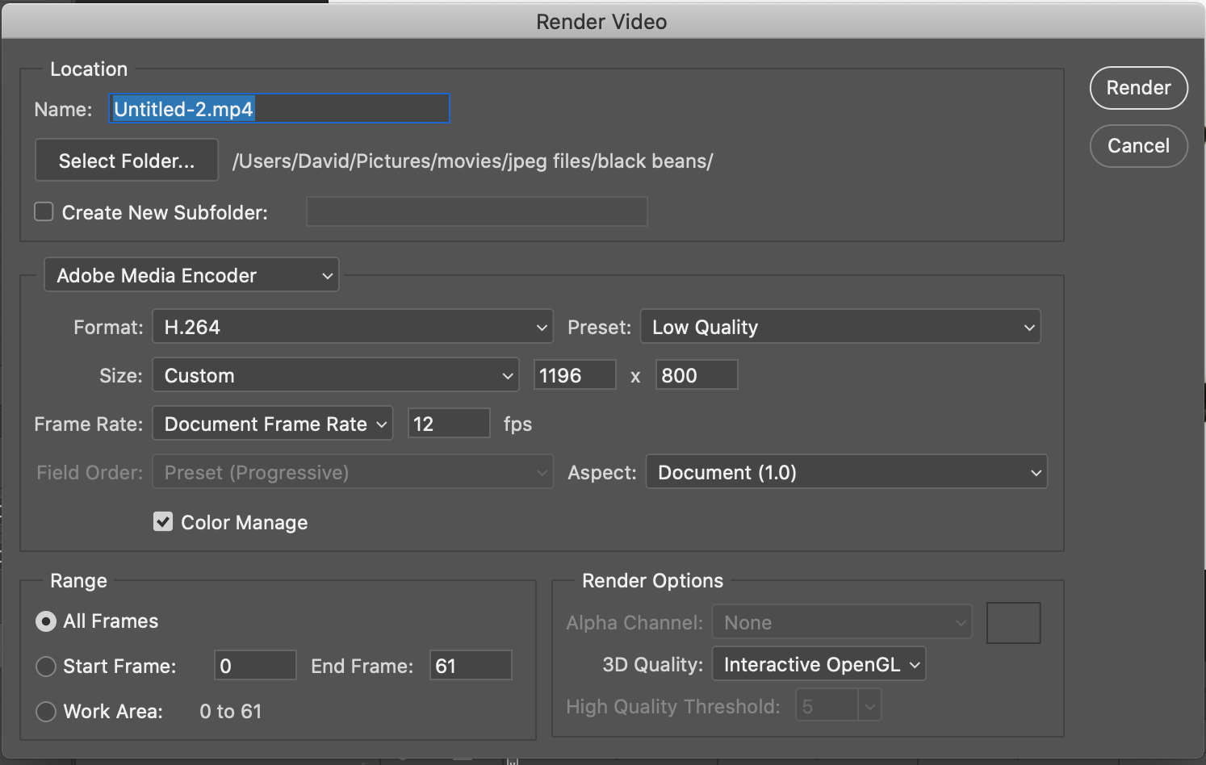

Slide 24
Challenge:
Make a Time-Lapse
Video!
to present next month!

Slide 25
Examples
-movement of sun or stars
-“a day in the life. . .”
-give motion to inanimate objects
-watch a flower open & close
-build something
-take something apart

Slide 26
and
.
.
.

Slide 27
and
.
.
.
1
your choice
You!!
any
now
ACTION!!

Slide 28
Here’s a tutorial showing the technique.
There are many more online—search for
“making a video from still images”
https://improvephotography.com/41051/creating-amazing-time-lapse-videos-photoshop/

