Slide 1
Solar Eclipse Photography
Dennis Freeman
October 19, 2017

Slide 2
Planning
What to Shoot? The Quarry.
Camera Gear Planning
Camera Settings
Venue Planning
Location Planning (the last thing, really)
Post-Processing Considerations

Slide 3
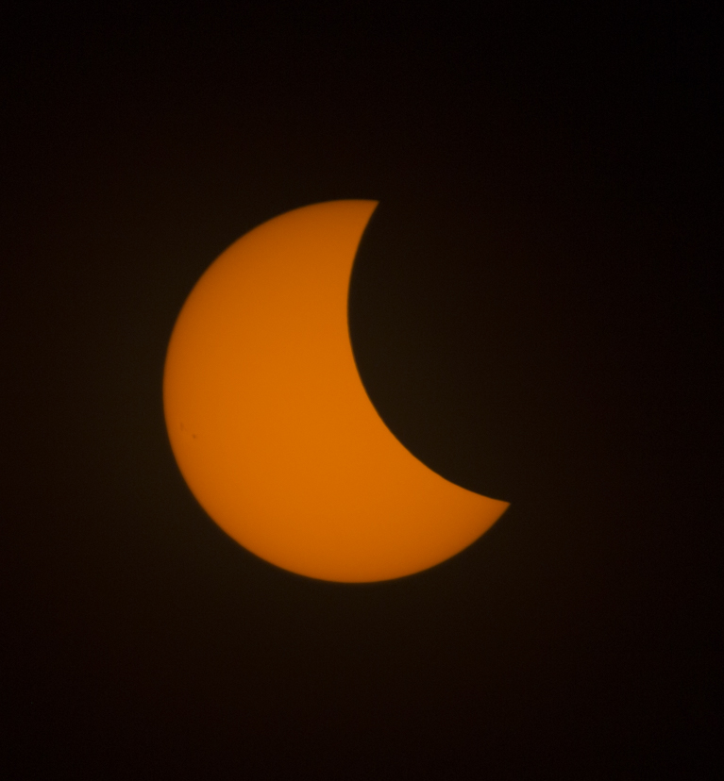
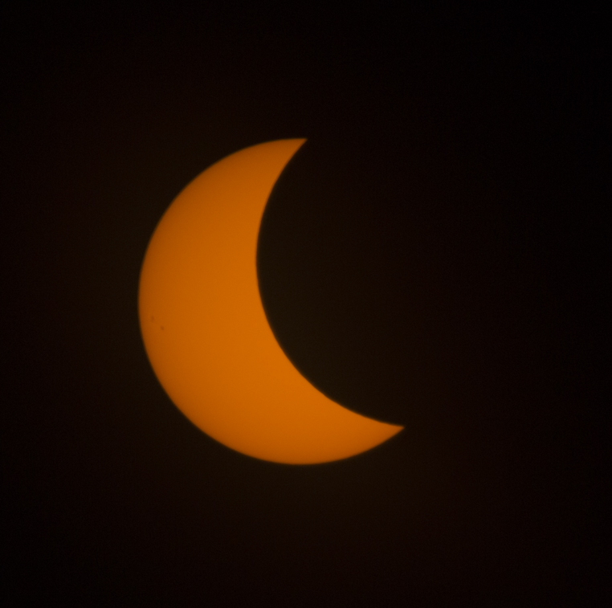
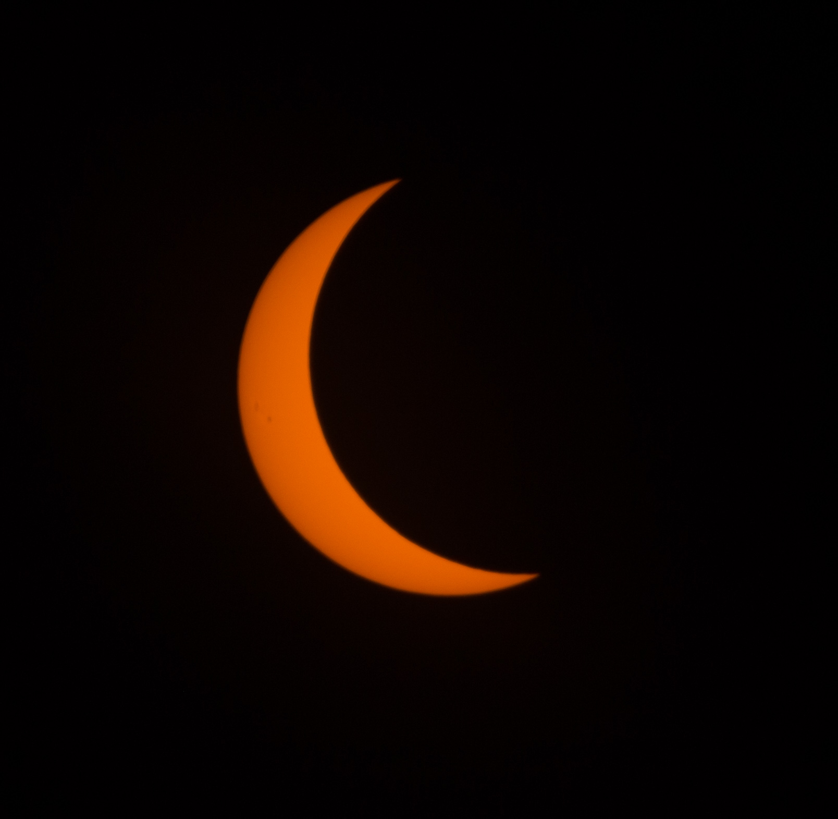
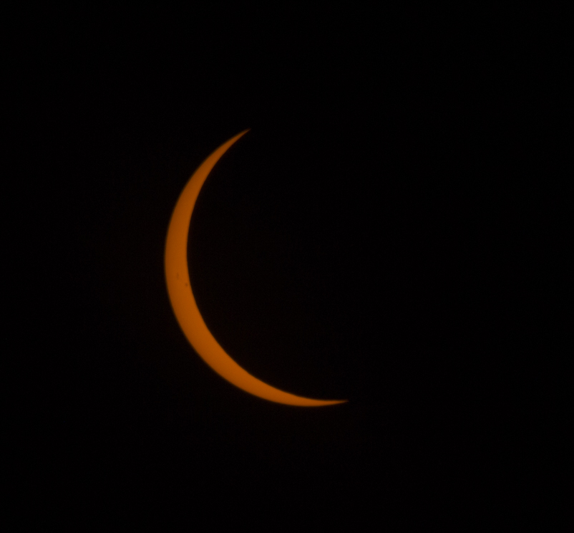
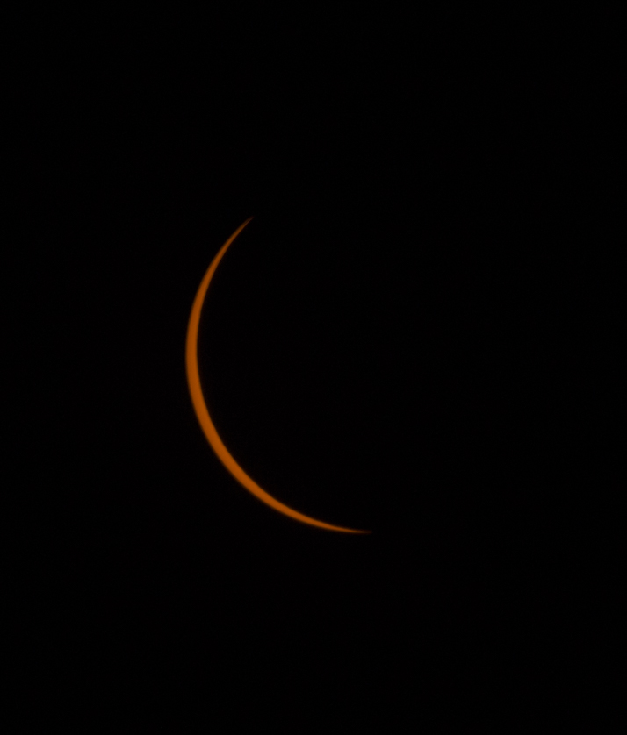
The Quarry – Part 1 (Partial Phases)

Slide 4
The Quarry – Part 2
Baily’s Beads (sunlight shining through deep valleys along the irregular limb of the Moon)
Chromosphere (a thin red layer that sits just above the solar photosphere)
Prominences (large, bright features anchored to the Sun's surface in the photosphere, and extend outwards into the Sun's hot outer atmosphere, the solar corona)

Slide 5
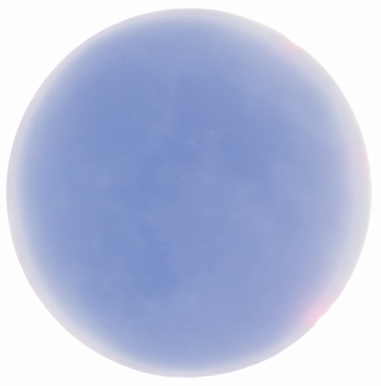
The Quarry – Part 3
Corona
Inner
Middle
Outer
Diamond Ring
Earthshine
“Full” Earth lights up the moon’s face during totality.

Slide 6
Gear Planning
Camera System
Lens Selection (e.g. 400 – 600 mm): Sigma 150-600 mm
Camera (with manual settings): Canon 6D
Option: Intervalometer: Vello
Tripod with Ballhead (e.g. 65º Elevation! ) Yes
Option: Equatorial Mount No
Loads of charged batteries Yes
12312-2 ISO-certified Solar Filter for Lens (for Preparation and Partial Phases) DayStar brand
12312-2 ISO-certified Solar Glasses DayStar sent 5 gratis

Slide 7
Lens Selections for Corona

Slide 8
Lens Selections for Various Phenomena
Canon 6D DSLR with Sigma 150-600 @ 600 mm
1,200 mm for close ups of prominences, chromosphere, Baily's beads
600 - 800 mm for video of corona.
400+ mm for diamond ring and decent sized corona.
400+ mm for time-lapse of all phases.
180 mm for maximum corona and nearby stars/planets.
85 mm for portraits of folks watching (extra points given for eclipse reflected in glasses).
50 mm for eclipse crescents and group portraits.
Wide-angle video with cell phones or DSLR for people’s reactions during totality.
Olympus OM-D EM-5 Mk II (micro 4/3 with standard zoom: 12-70 mm)

Slide 9
Intervalometer
An external device (or internal on some cameras) that allows for delayed or regular shutter release. Plugs into port on camera.
E.g. Shoot once per second forever.
Shoot once every 5 seconds for 10 shots.
Etc.
Can set to do regular partial phases (e.g. every 5 min.)
I set mine to shoot continuously, indefinitely, during totality
It fell out! Probably when I was getting up I snagged it.
I resorted to manual shutter release.
Need to secure cable better next time.

Slide 10
Optical Density (Neutral Density Filter) vs % Transmittance vs Required Shutter Speed at f/16 and ISO 200
ND % TRANS SHUTTER NOTES .
5 0.001% 1/250 Baader Visual, Daystar Visual
4 0.01% 1/2,500
3.8 0.016% 1/4,000 Baader Photo Density
0.1% 1/25,000
1% 1/250,000
1 10% 1/2,500,000
0 100% 1/25,000,000 Sun unfiltered
DSLR camera
shutter speeds

Slide 11
DayStar Solar Filter ($25 for 90 mm)
The DayStar Filters White-Light Universal Lens Solar Filter allows you to safely view or photograph the sun and solar eclipses. Its filter is made of the 12312-2 ISO-certified SOLARITE film, which stops more than 99.999% of light, plus 100% of harmful IR and UV radiation. If too big for lens, make a ring of foam to fit inside the cardboard, making a snug fit.

Slide 12
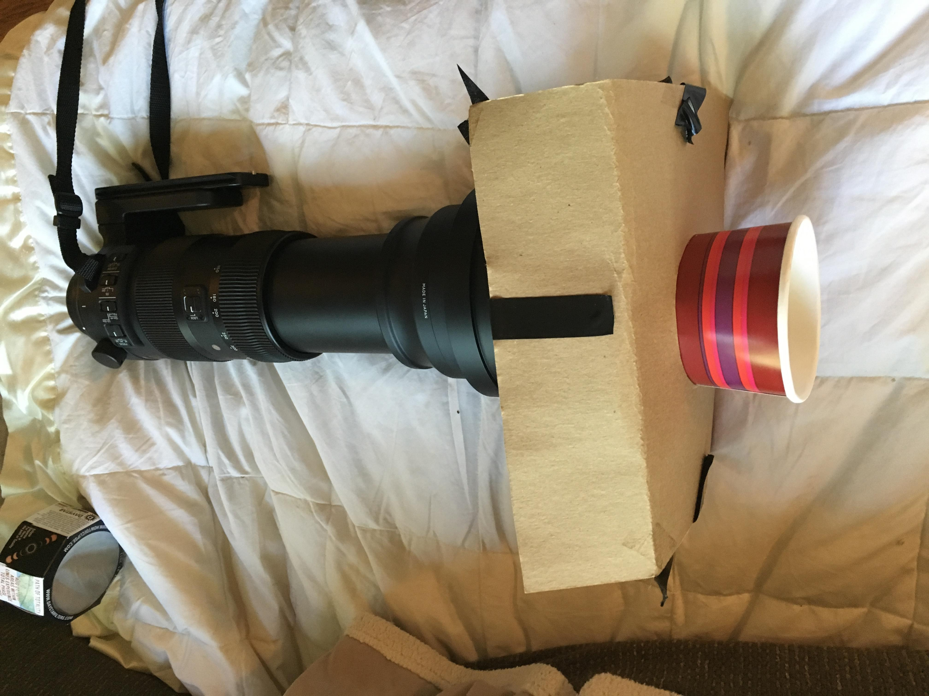
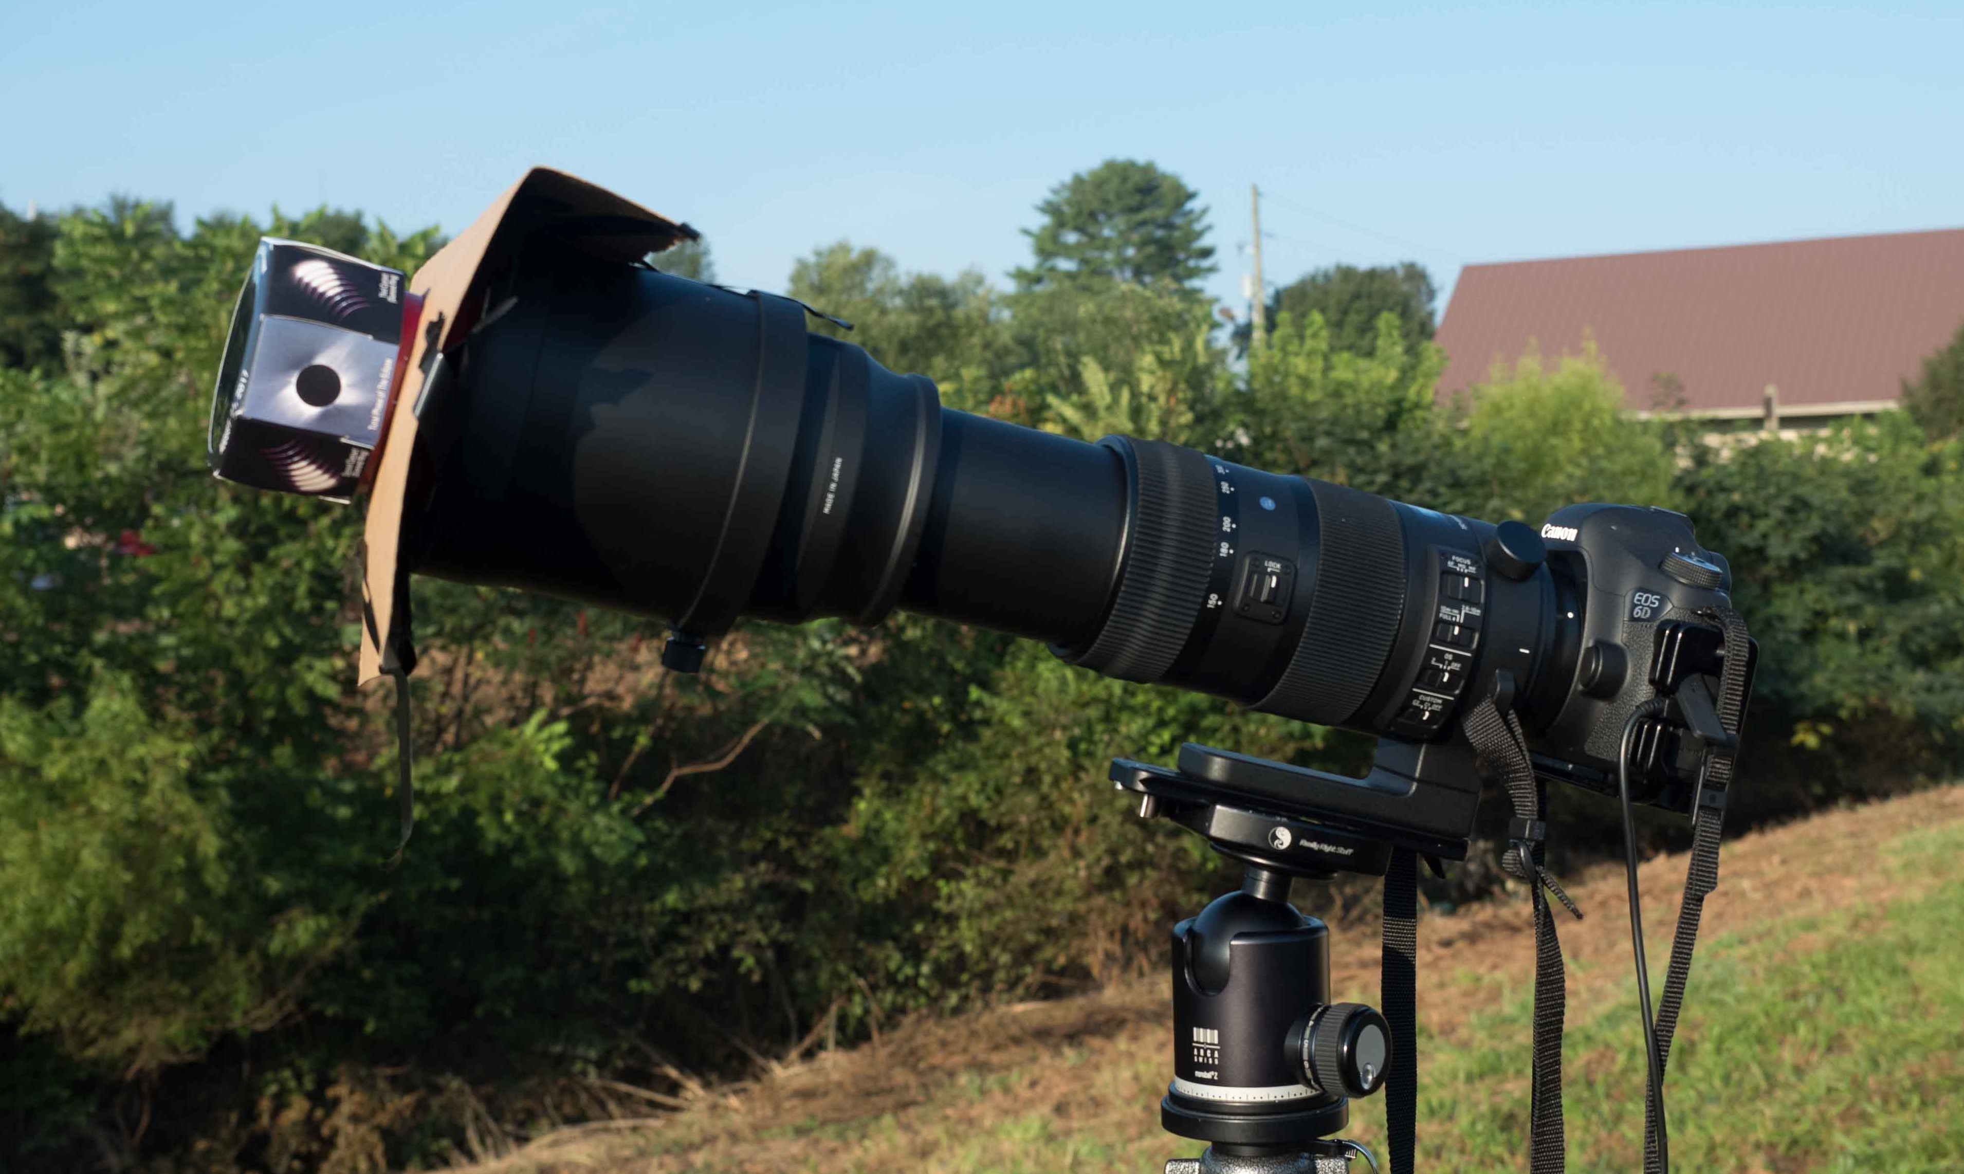
Problem
My lens was a Sigma 150-600 mm with outer diameter > Solar Filter
Originally going to use Olympus micro 4/3 with 70-150 mm lens & 1.4 x teleconverter during partial phases. Forgot about lining up Sigma prior to totality.
Build Sigma adapter in hotel room. Used for both partial phases & totality.
Some photographers used sheets of solar film & rubber bands!

Slide 13
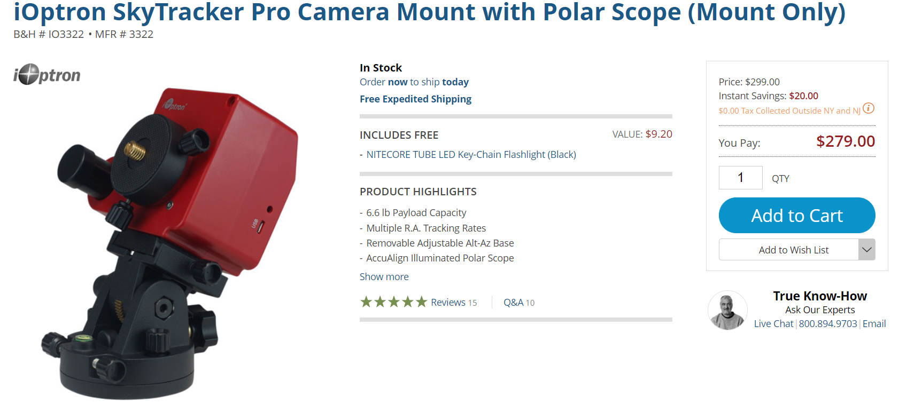
Point and Forget
If you can set up your tripod the night before, and leave it, consider an equatorial mount that keeps the sun fixed in the photographic frame throughout the entire event. It must be aligned with the polar axis (i.e. a smidge from the North Star) the night before.
There are approaches for less accurate alignment during the day.
You may need a counterbalance for heavy camera and lens.
I didn’t have this.

Slide 14
Camera Settings 1
My Canon has up to 7 exposures (evenly spaced stops) in a bracket, so each click of shutter does all 7 in a row. I selected:
1/125 sec
1/50
1/20
1/8
0.3
0.8
2.0

Slide 15
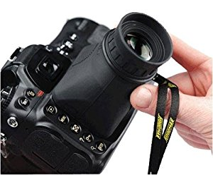
Camera Settings 2
Manual Focus Lens to infinity, tape it down
Infinity mark on lens may not be accurate
Suggestion to focus on sunspots before eclipse
Bring towel to hood your head over camera back
Hoodman Loupe
Manual ISO, e.g. 200
Manual White Balance (Sunny)
Manual Program Mode
Aperture, f/8
Totality Shutter Speed Bracket [1/125, 1/50, 1/20, 1/8, 0.3, 0.8, 2.0]
Partial Phases Shutter: Can vary. I used 1/160 sec with the DayStar ND (5) Filter

Slide 16
Finding the Sun with a Solar Filter on Camera
With a safe solar filter on your lens, all you're going to see when the Sun is not in the frame is black. So how do you get the Sun in the frame, particularly if you are at a long focal length? First, un-zoom a zoom lens to the shortest focal length.
The easiest way is with a solar finder. It can be something simple like a small device (e.g. mounted in the hot shoe of your camera) with a simple pinhole that projects an image of the Sun onto a flat surface. You can even make one of these yourself.
If you don't have a solar finder: Put on your solar glasses to orient the camera to the general neighborhood – take off glasses. Then look at the shadow cast on the ground by your camera and lens. As you (blindly) move the camera around to aim it, you will notice the shadow becomes the smallest when it is pointed right at the Sun.
Fine tune through the viewfinder/Live View, then re-zoom to long focal length.
Revisit pointing direction frequently as the sun moves across the sky.

Slide 17
Most Likely Posture During Setup & Totality
Steep lens elevation, and non-adjustable DSLR camera back requires you to squat or sit under camera, with tripod tilted back – thus.
You will be re-pointing the lens every minute or so during totality (unless you have an equatorial mount)

Slide 18
Venue Planning
Drinking Water
Ice Chest
Food
Sun Screen
Bug Spray
Beach Umbrella / Canopy
Towel for head and camera
Shade/Ventilation for camera when not in use (don’t cook it in the sun all day!)
Chair
Sunglasses
Solar glasses, binoculars with solar filters (e.g. DayStar)
Walk-around camera (e.g. cell phone, compact)
Duct Tape, Leatherman, … – you never know.

Slide 19
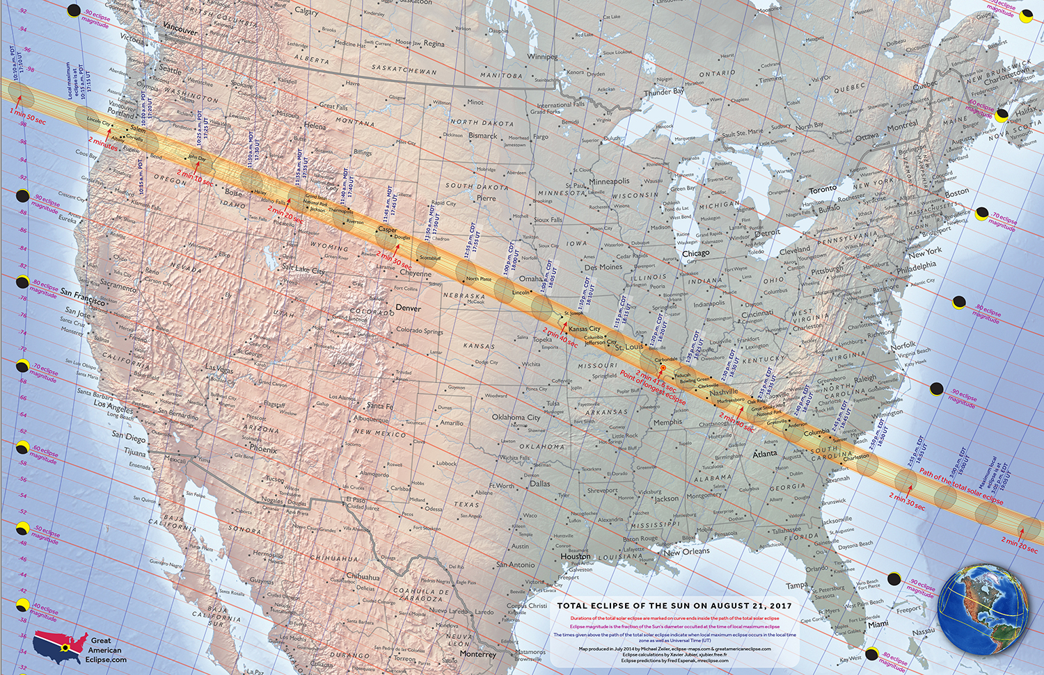
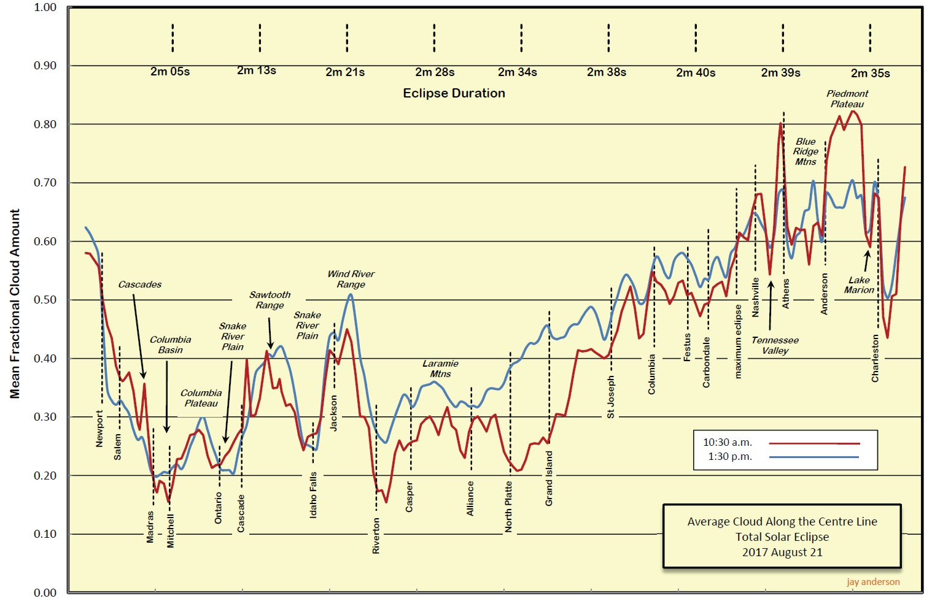
Location Planning 1: August 21, 2017
Cloud stats look good – sold out hotels, rip-off flight $$$.
My preferred driving distance – cloud stats look kind of bad.

Slide 20
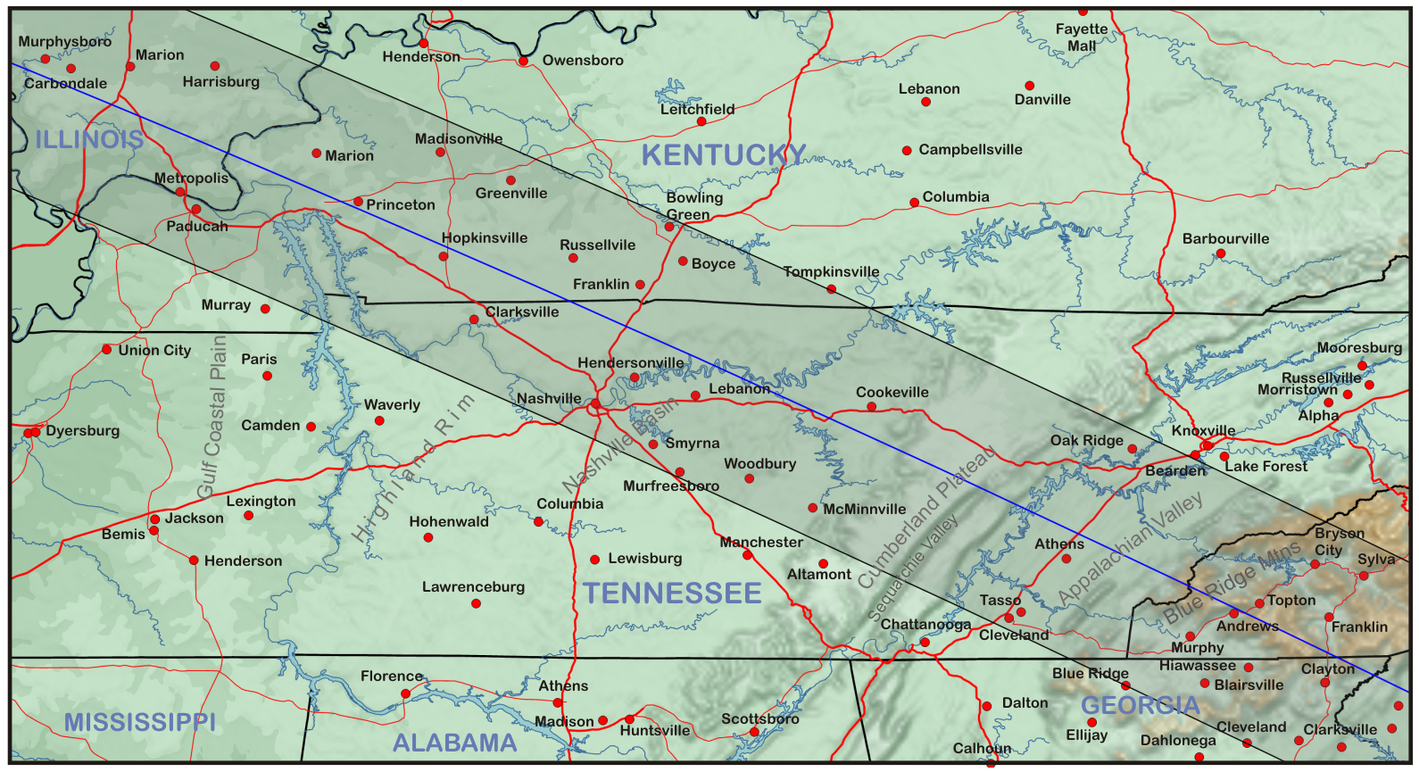
Location Selection 2
By Thursday morning (T-minus 4 days), Tennessee looking good for weather – partly cloudy in p.m. Now where?
Towns within totality sold out or outrageous hotel prices. Big cities have more hotels – greater chance of finding something. Knoxville is shorter drive – Go to Knoxville then drive to (tdb) for totality on Monday morning.

Slide 21
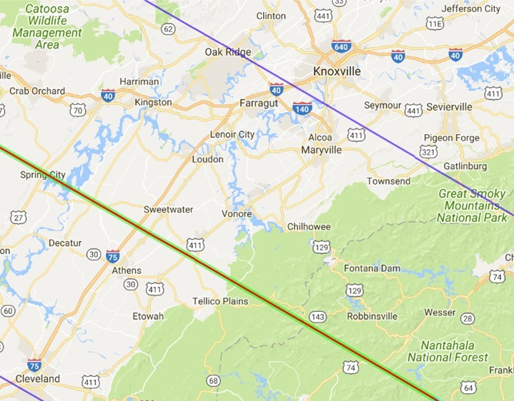
Location Selection 3
Line of Maximum Totality Duration (~2:38)
Found one of few remaining rooms in Knoxville – reserved for Sun. & Mon.
Departed Sunday a.m. – arrived 3:00 p.m. in Knoxville
Where to on Monday?
Spring City?
Sweetwater?
OMG: No Parking Remains! 50 Mile Traffic Jams Expected!
Hmmm – what’s this?

Slide 22
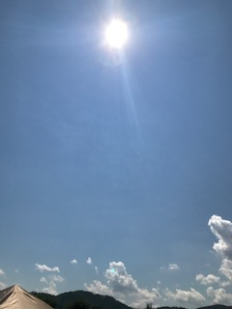
Location Planning 4 – Tellico was on Facebook
3-Day Eclipse Astronomy/Photography Event – camping and eclipse parking ($5)
Porta-Johns
Food Booths
Water
Security
Medical
Music
Parking lot opens 6:00 a.m.
Done!
Departed hotel at 4:45 a.m., arrived at 6:00 a.m. and paid my $5.
Note: Parking lot full by 9:30 a.m. – huge line of cars turned around …
Venue was perfect. Clouds stayed on horizon.
Getting back to Knoxville was awful. Hours in stop-and-go traffic.

Slide 23
HDR (High Dynamic Range) Processing
To shoot an HDR image showing detail in the full corona, you will need to shoot a series of exposures from very short to very long. These exposures are usually separated by about 1 f/stop in shutter speed. Then these exposures are digitally composited with masks in Photoshop, or with a special HDR program.
Photomatix for Windows & Mac OS X
Aurora HDR 2017 for Mac OS X
HDR Efex Pro for Windows & Mac OS X (plug-in for Adobe Photoshop or Lightroom from the Google Nik Collection)
Photoshop CC Merge to HDR function.
Not mine! I’m having trouble with alignment – i.e. sun moves, and my auto-alignment tool doesn’t like the image.

Slide 24
April 8, 2024: Total Solar Eclipse, Texas-to-Maine
e.g. Winchester, IN
1:52 p.m. – 4:24 p.m.
Totality: ~ 4 minutes!
Elevation at totality ~52º

Slide 25
April Ave. Fractional Cloud Cover – NASA Data
http://eclipsophile.com/future-eclipses-2019-2024/
Best Cloud Stats
Texas
Oklahoma
Arkansas
Missouri
Illinois
Indiana
S.W. Ohio

